Slide 1
Zoonotic disease:
Disease which are primary effect animal but occasionally cause disease in man (e.g Brucellosis).

Slide 2
Brucellosis:
Zoonotic disease of public health.
Causative agent:-
Brucella abortus (affected cattle & sheep )
Brucella melitensis (affected sheep,goat &man)
Brucella suis (affected swine )
Brucella melitensis occur more frequently than other types , in general population and it is most pathogenic & more virulent than other species.

Slide 3
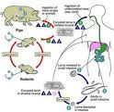

Slide 4
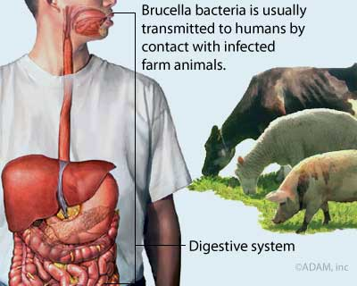

Slide 5
Disease in man:
Mediterranean fever , undulant fever ,Malta fever .
The incubation period usually (1 to 3 weeks) .
Symptoms include fever,headache,chills,orchitis, weakness , nausea . weight loss & splenomegaly .

Slide 6
Contamination of milk:-
The organisms gain entrance to milk from (Udder or by pollution of milk during & after production with the animals infectious discharge especially aborted fetuses , fluids or membranes or urine .
Diagnosis:
Rapid Slide agglutation test ,Ring test form milk sample .

Slide 7
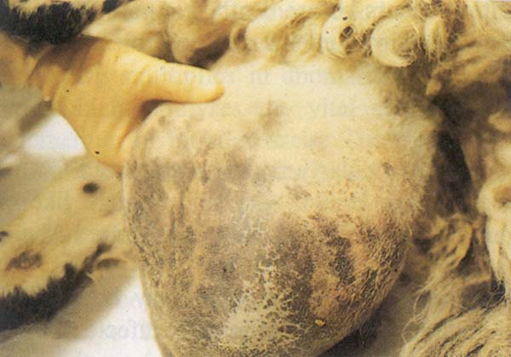

Slide 8
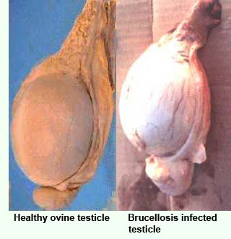

Slide 9
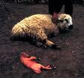

Slide 10
Bovine tuberculosis:
It is a chronic & acute bacterial infection .
Causative agent:
G+,acid fast , aerobic ,bacillus of Mycobacterium genera. The most common are(bovine , avium ,hominis ) .All three types are capable of causing disease in human but (Myco.bovis ) is the species responsible for cattle affection .

Slide 11
Disease in man:
Can occur (2 to 3)months after infection or years later. So the clinical syptom in humans depend on the organ system involved , primarily attacks the (Lung) ,but which may also affect the kidneys ,bones ,lymphnodes ,and brain .
Symptoms of pulmonary TB include : (coughing,sputum,production ,chest pain,shortness of breath,loss of appetite ,weight loss,fever,chills &fatigue ) .Skin lesion characterized by (ulcer or by popular lesion progressing to dark suppurative lesions) .

Slide 12
Contamination of milk :
1-The affected animal( milk but udder remins un-affected).
2-Milk (from affected animal or human).
3-Infected sputum(from animali&orhuman).

Slide 13
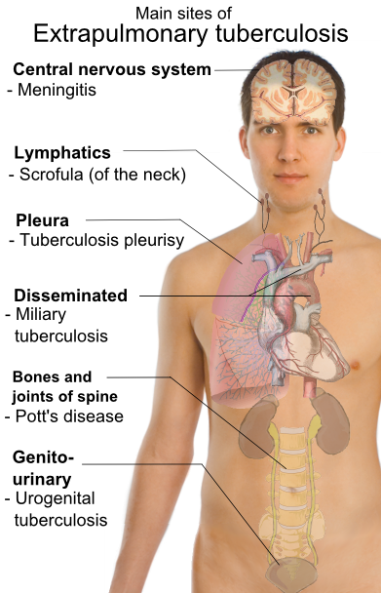

Slide 14
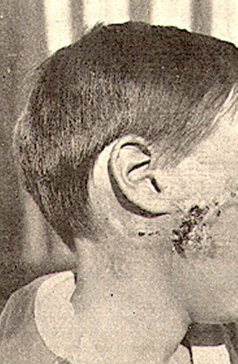

Slide 15
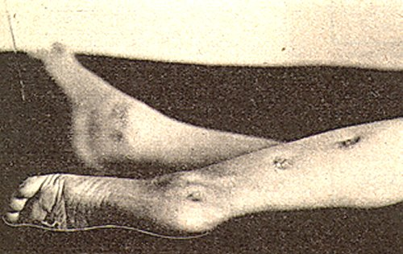

Slide 16
Diagnosis:
1-Intradermal Tuberculine test .
2- Radiography. Chest X-ray .
3- Acid fast stained sputum smear or other body fluids & tissues .

Slide 17
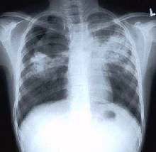

Slide 18
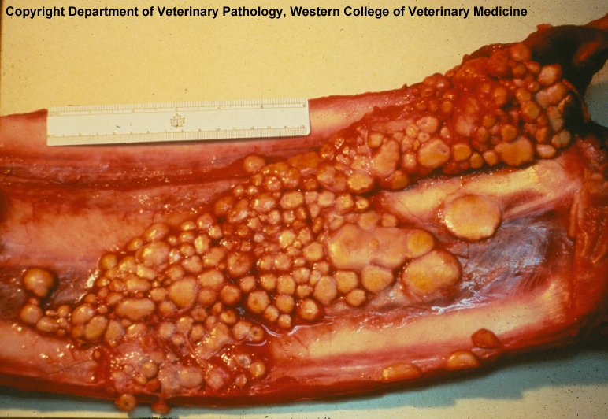

Slide 19
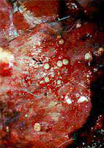

Slide 20
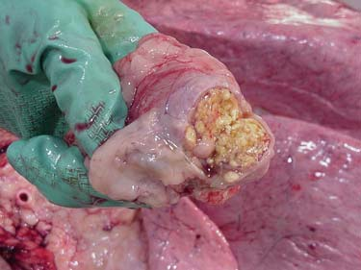

Slide 21
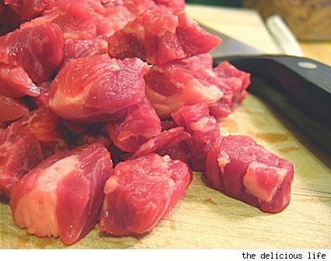

Slide 22
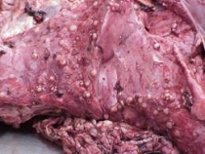

Slide 23
Anthrax:
An acute bacterial infection of humans &animals.
The disease wourdwide&is enzootic in certain African&Asian countries .
Causative agent :
Bacillus anthracis(bacterium) , G+ spore- forming aerobic rod.
Disease in man:
Incubation period is usually with in (7 days).
There are 3 types if it is occur:-
1-Cutaneous form (malignant pustule)
Most common I.P(1-7days),then Papule appears on an exposed area of skin & becomes Vesicular .

Slide 24
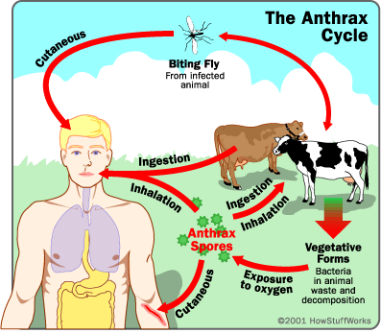

Slide 25
2-Pulmonary from (wool sorters disease ):
I.p(1-5days),fever,cough ,dyspnea respiuratory failure & death in (24 hours) as a result of pneumonia .100%fatality.
3-Intestinal form :
I.p(12hours—5days),man is infected by handling contaminated carcasses ,wool,hide,or hair .Also can be infected by ingestion or inhalation of spores or bacilli .

Slide 26
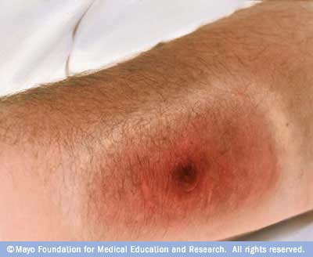

Slide 27
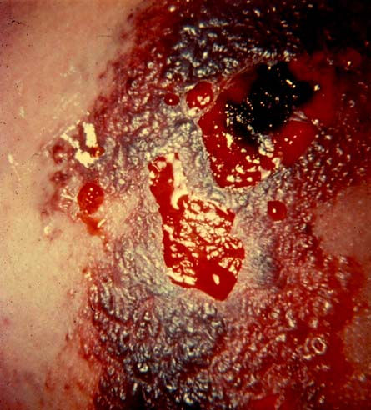

Slide 28
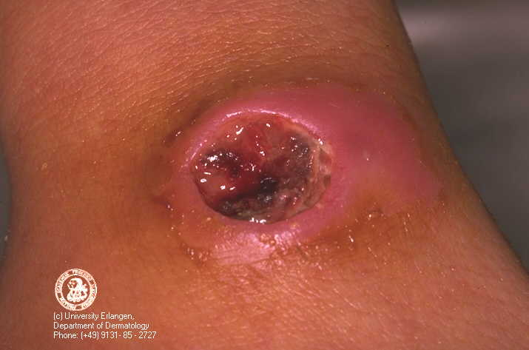

Slide 29
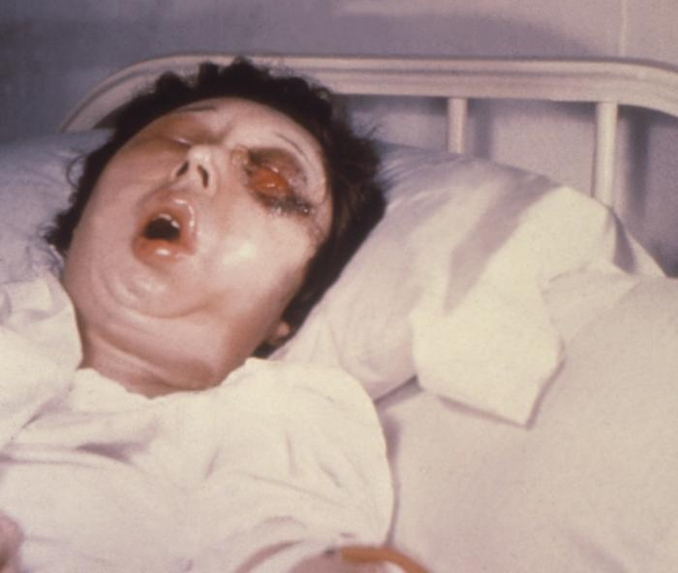

Slide 30
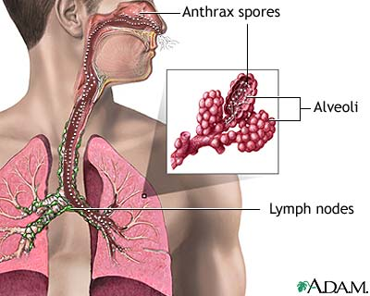

Slide 31
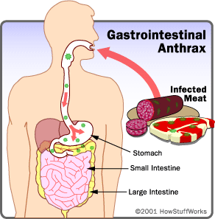

Slide 32
There are No reports of disease spreading from human to human.
Anthrax rare transmuted throw or during milk because the organism exposed into milk in shortly before death of animal & milk yield decrease & rare &can conataminated from environment &infected man.

Slide 33
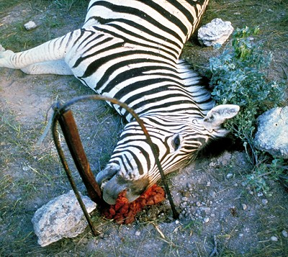

Slide 34
Q-Fever:
Is an infectious disease of wild & domestic animal (sheep, goat & cattle ) with numerous Tick hosts.
Causative agent:
Rickettica ( Coxiella burnetii) ,G-ve,obligate intracellular bacteria. Stains red with Gimenez&Macchiavello stains &purple with Giemsa.

Slide 35
It is name from its a etiology which remained unknown or Questionable for quite sometime.

Slide 36
Disease in man:
Occur due to consumption of infected milk. ( Aerosol is a major means of transmission) & symptoms include headache,fever,chills ,muscle aches,and general feeling of ill health.No skin eruption or rash .

Slide 37
Contamination of milk: Organism shed in urine ,feces and milk ( udder&milk appears normal) amniotic &fetal tissue are highly infective & the organism resistant to drying,heat & may survive some unsatisfactory time-temperature combinations used for heat treatment.

Slide 38
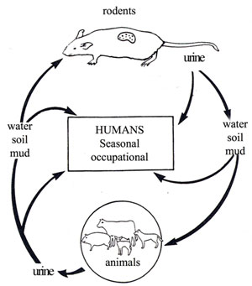

Slide 39
Diagnosis:
1-Use of IFA(immunofluorescent antibodies ).
2- Organism can be inoculated into tissue culture & grow over (4 to 7 days) but this is very hazardous to personnel.

Slide 40
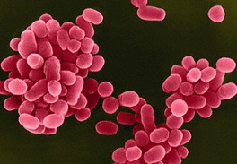

Slide 41
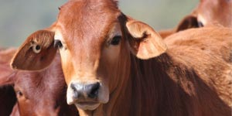

Slide 42
Rabise(Lysa ,Hydrophobia ):
Is an infectious zoonotic viral disease that can affect all species of warm-blooded animal including man.
Causative agent :
Rhabdovirus ,which causes an acute almost invariably fatal disease that affect the salivary glands&the C.N.S.

Slide 43
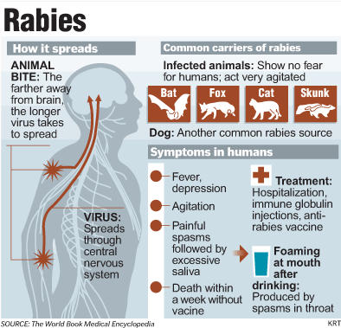

Slide 44
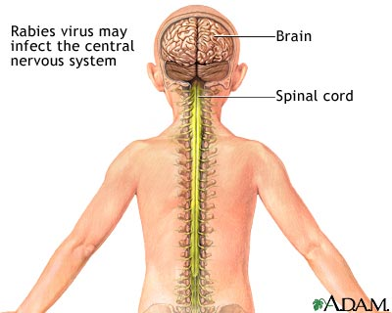

Slide 46
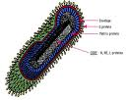

Slide 47
Disease in man:
There is usually a history of animal bite. Pain appear in the side of bite ,attempts or tried of drinking caused extremely painful laryngeal spasm , so that the patient refuses to drink (hydrophobia). The causative agent is Found in the domestic & wild animals & can transmitted to other animals & human through close contacts with their saliva (i.e.bites,scratches,licks on broken skin & mucous membrane).

Slide 49
Clinical symptom are muscle spasm ,laryngospasm, convulsions occur ,large amounts of thick saliva are present.

Slide 50
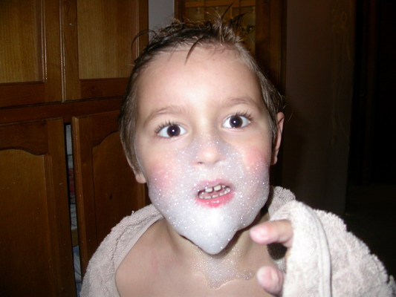

Slide 51
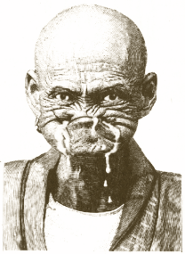

Slide 52
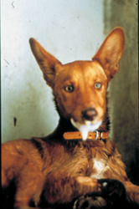

Slide 53
Contamination of milk:
Virus shed in milk & saliva of infected animal.
Cases of rabies in man due to consumption of raw milk are recorded & the virus get entrance through an abrasion in the intestine of consumer ,but the spreading of rabies by consumption of milk is rare.

Slide 54
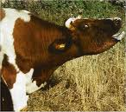

Slide 55
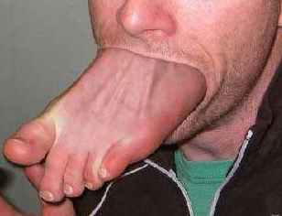

Slide 56
Foot and Mouth disease:
Is aviral infection caused by astrain of Coxsackie virus .

Slide 57
Disease in man:
Most often occur in young children(under 10 years old), symptoms of fever, poor appetite,runny nose&sore throat can (3 to 5)days after exposure.Ablister like rash on hands ,feet&in the mouth usually developes (1 to 2 days) after the intial symptoms, the illaness is typically mild ,complications are rare.

Slide 58
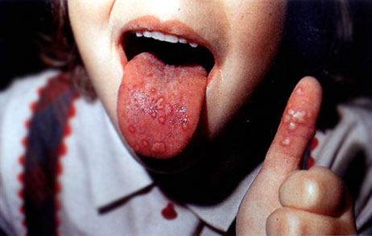

Slide 59
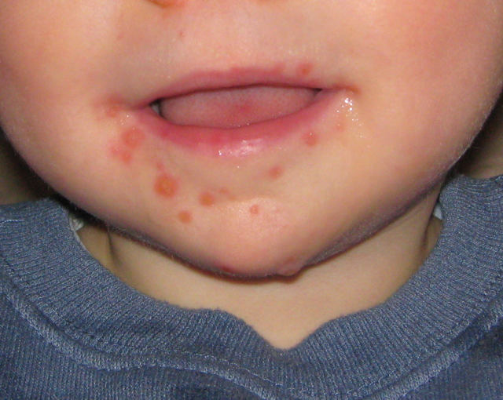

Slide 60
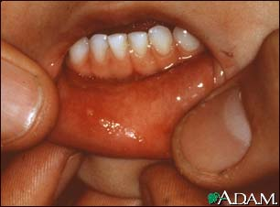

Slide 61
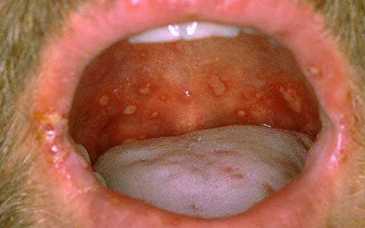

Slide 62
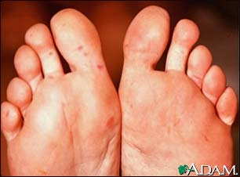

Slide 63
The virus has been known to be shed in the stool for up to several weeks.Also virus occur in fluids inside the blasters.

Slide 64
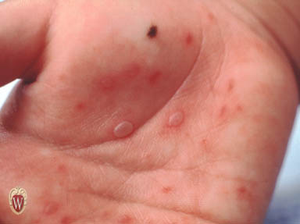

Slide 65
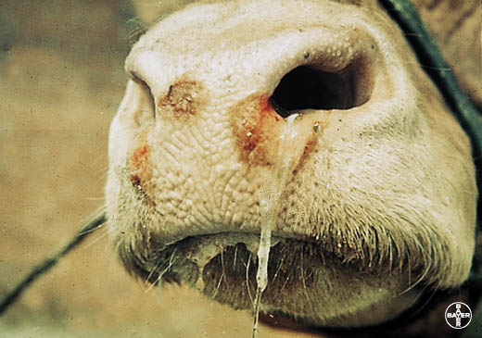

Slide 66
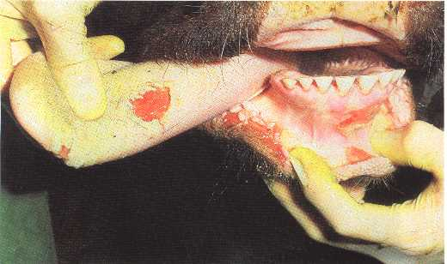

Slide 67
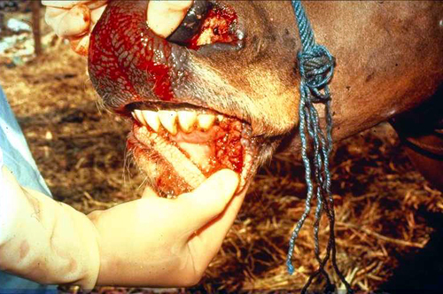

Slide 68
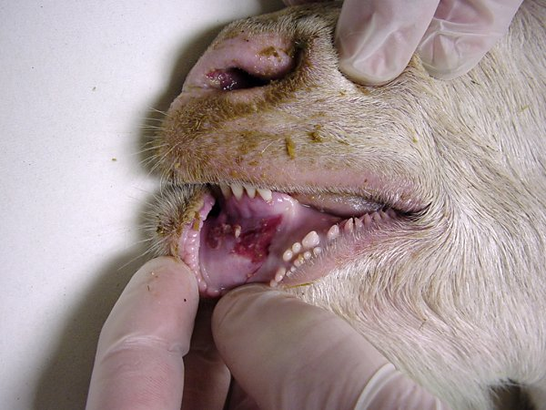

Slide 69
Contamination of milk:
1-Directly from(vesicles on udder& infected milkers hands).
2-Affected animals: shed m.os in milk or contaminated from the nouse & throat discharges & feces of infected people .
3-Envirounment from dried dust contain virus.

Slide 70
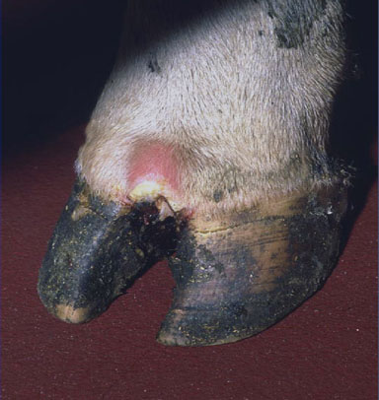

Slide 71
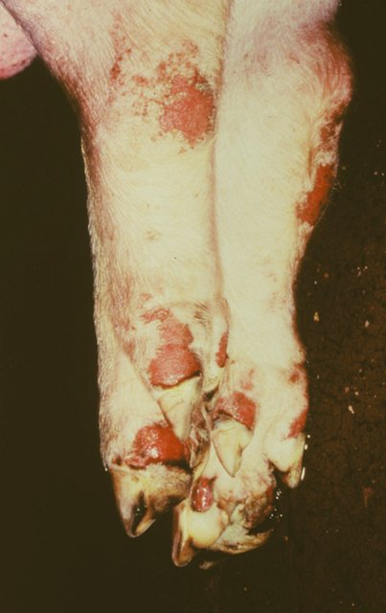

Slide 72
Cow pox:
Is viral disease caused by vaccinia Virus.
Disease in man :
On rare occasions, cowpox may be transmitted to humans & produce characteristic red skin rash & abnormally enlarged lymph nodes.
In cause pox exanthema in face & milkers nodules in hands.

Slide 73
Contamination of milk:
From ( udder lesions& nodules in Milkers hands & also from environment).

Slide 74
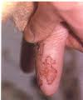

Slide 75
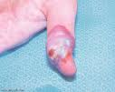

Slide 78
Campylobacteriosis (Vibriosis ,vibronic abortion):
Causative agent:
Caused by species of genus Campylobacter ( C.jejuni,C.fetus&C.coli are the usual causes of campylobacteriosis in people ).
Campylobacter bacteria areG-ve, microaerophilic, curved ,motile rod .

Slide 79
Disease in man:
Onset of symptoms generally 2—5days after eating.
Last7—10days (Acute gastrointestinal illness, diarrhea with or without blood ,abdominal pain & fever).It may may cause pseudoappendicitis &rarely septicemia & arthritis .
Large outbreaks due to Campylobacter are usually associated with poultry , meat & raw milk .

Slide 80
Contamination of milk:
Either from udder, affected animal or human, or contamination of milk with the animals infectious discharge especially aborted fetuses ,fluids or membranes .

Slide 83
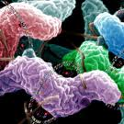

Slide 84
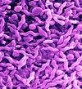

Slide 85
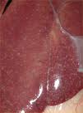

Slide 86
Listeriosis:
Was primarily of veterinary concern.Where it was associated with abortion & encephalitis in sheep & cattle( Circling disease).

Slide 89
Causative agent:
Listeria monocytogenes. G+ve,pleomorphic rod , resist heat,salt ,nitrite&acidity.They survive &grow at low temperatures.

Slide 91
Disease in man:
Primarily affects pregnant woman, newborn infant.
Outbreaks have been reported associated with ingestion& most recent(last) cases have involved raw milk,cheeses made with raw milk & milk contaminated post—pasteurization.

Slide 93
Listeriosis may occur as mild illnesswith such symptoms as (fever, headache, nausea & vomiting).
Among pregnant woman ,infection may affect the fetus resulting in abortion of still birth .If born alive, the infant may develop meningitis.

Slide 94
Contamination of milk:
1-Infected animal(shed m.o in milk).
2-Infected human.
3-Anamil discharge especially(aborted fetuses, fluid or membrans).

Slide 97
Yersinosis:
Causative agent:
Yersinia pseudotuberculosis , Y.enterocolitica
G (-ve),non-spore forming rods .

Slide 98
Disease in man:
Gastroenteritis is the most common symptom, acute watery diarrhea, mesenteric lymphadenitis whichcan be confused with appendicitis, fever ,headache,
pharyngitis, anorexia & vomiting .

Slide 99
Contamination of milk:
Direct or indirect contamination with contaminated fecal of man or animal& from uterine discharge in case of abortion .

Slide 104
Leptospirosis:
Causative agent:
Leptospira canicola , Lept.hardjo & Lept .pomona

Slide 105
Disease in man: Gastrointestinal disturbances ,weakness ,myalgia ,malase,chills & fever .

Slide 112
Contamination of milk:
1-Direct from animal 2- Indirect from feces of man & animals & aborted discharge.

Slide 115
Actenomycosis:
Causative agent:
Actinomyces bovis(fungi)

Slide 116
Disease in man:
If present in milk the organism entrance to some new wound such as new tooth cavity ,intestinal ulcer or labial sore, which may be leadeing to abscess formation.The organism produce enterotoxins in milk which give rise to violent diarrhea &sickness when milk is ingested.

Slide 119
Disease of human:
Typhoid fever(Slmonella typhi infection)or(Alteric fever)or(Salmonella fever) :
Causative agent:
Typhoid bacillus Salmonella typhi

Slide 120
Disease in man:
Characterized by sudden onset of continued fever ,headache,nusea,loss of appetite,constipation or some times diarrhea.
Typhoid germs are passed in the feces and,to some extent, the urine of infected people.

Slide 121
Contamination of milk:
By food&water contaminated by the feces &urine of patients &carriers.Polluted water is the most common source of typhoid ,in additionas, contaminated milk &milk products have been shown as a source of infection .

Slide 122
Bad habits:When ahuman patient/carriers dosenot wash hands after using the toilet &then handles liquid or moist food that is not cooked thoroughly afterwards .

Slide 123
Paratyphoid fever(Interic fever)(Salmonella paratyphoid infection):
Causative agent:
Caused by any of three bioserotypes of Salmonell enteritidis Paratyphi A, B
and C.

Slide 124
It is similar in its symptoms to typhoid fever,but tends to be milder .It is similar also to typhoid fever in mode of milk infection,transmission&control.

Slide 126
Dysentery:
(Shegellosis)(Bacillary dysentery)(Shegella):
Dysentery may be simple defined of shigella as diarrhea containing Blood.

Slide 127
Causative agent:
Shigella dysenteria , S.flexneri ,S.boydii & S. sonnei.
Disease in human:
It seen most often in preschool-age children.
In addition to bloody diarrhea ,the illness caused by pass shigella often includes abdominal cramps ,fever & rectal pain.

Slide 128
Most pepole pass shigella organism in their feces(stool) .Stool also contain blood ,mucus,&pus.
The most likely modes of transmission are person-to-person contact ,and contaminated water & food.
The most common mode of transmission of entric fever group is the fecal-oral route.

Slide 129
Cholera:
Is an acute intestinal infection, endemic in some tropical countries. It is mainly a disease of young children.
Causative agent:
Caused by bacterium Vibrio cholera.

Slide 130
Disease in man:
It has a short incubation period ,from less than(1 to 5 days),the symptoms of cholera are diarrhea &the loss of water &salt in stool. In severe cholera ,the patent develops violent diarrhea with characteristic (rice-water stool),vomiting ,thirst, muscle cramps. Fever is usually absent. Death can be occur if treatment is not promptly given.

Slide 131
Contamination of milk transmission:
The cholera germ is passed in the stool. It is spread by eating or drinking food( including milk &milk products)or water contaminated, directly or indirectly through the fecal waste of infected person.

Slide 133
Diphtheria:
Acute bacterial disease that usually affected tonsils, throat, nose &skin .
Causative agent:
Corynebacterium diphtheria

Slide 134
Disease in man:
Symptom usually appear (2—4 days) after infection .
There are (2) types :one type involve nose & throat , and other type involve skin .
Symptom include sore throat ,fever , enlargement of L.N in neck.
Skin lesion may be pain full ,swelling & redness.

Slide 136
Septic sore throat and Scarlet fever:
Bacterial diseases caused by Streptococcus biogen.
There are several strains some of them caused this diseases.
Septic sore throat : it symptom in man are: fever ,sever inflammation of throat & swelling of L.N , coughing ,sneezing & nasal discharge .

Slide 138
Scarlet fever :Its symptom in man is similar to S.s.throat
Note:
Affected animal (mastitis) may discharge the organisms for length period in milk .

Slide 139
Hepatitis:(Infectious hepatitis , Epidemic hepatitis, Epidemic jaundice )
Hepatitis is inflammation of liver caused by virus:
(HAvirus,HBv,HCv,HDv,HEv &HGv).

Slide 141
Poliomyelitis (Infant paralysis):
Infectious viral disease that some time paralysis infection, chiefly infection children & young adult & caused by any one of relative virus called Polio virus.

Slide 142
Human tuberculosis :
It is caused by G+ve,cid fast,aerobic Mycobacterium.
The most common are ; Myco.bovis(Dog,cattle,swine)
Myco.avium(Bird,swine,sheep)
Myco.tub.varality humanus(Man,cattle .swine)
All(3)types are capable to caused disease in man .

Slide 143
Food poisoning :
Divided in to three main group which are:
A—Food intoxication :
1—Staphylococcal intoxication:
Staphylococcal aureus is (G+ve),produce toxin called
(Enterotoxine) which is heat stable, while other spaces of Staphylococcal produce heat labial toxins.
Incubation period 2—4 hours.
The principle sources of Staph.aureus in human in skin,face,nose ,and most clinical symptoms are vomiting with diarrhea.

Slide 144
2—Botulism :
Clostridium botulinum produce also toxin in canning .
3—Clostridium perifringens produce enterotoxin.
4—Bacillus cereus produce also entertoxin which caused food poisoning .

Slide 145
B—Food poisoning infection:
1—Salmonellosis:
Caused by Salmonella typhimurium , Salmo.entertiidis &Salmonella weltiverdin.
The incubation period by Salmonella infection is (12-24 hrs) .
The clinical symptoms are Fever, vomiting ,diarrhea with abdominal pain or cramps .

Slide 146
2—Campylobacter food poisoning infection:
Caused by Camp. Enteritis .
3—Shigella infection(Bacillary dysentery):
Caused by Shigella sonni .
4—Listeriosis :
Caused by List.monocytogenus.
5—Yersiniosis :
Caused by Yers.enterocolotica .
6—Entero hemorrhagic:
Caused byE.coli(O157:M7).

Slide 147
7—Cholera :Caused by Vibrio cholera.
8—Vibrio infection :
Caused by Vibrio para hemolyticus , V.foluncus .
C—Toxi-infection:
Clostridium botulinum spore former bacteria .

Slide 148
Health meat(Meat hygiene): Is the science that deals with the examination of the meat and its products from the product until it reaches the consume You must provide good quality acceptable to the meat and its products to the consumer and must be the meat :- (1) Free of taste or odor non-acceptable. (2) Conform to the specifications sound even consumer refused it. (3) Free of any of the diseases that may affect the individual as a result of covered(consumer) or circulation and that may be the causes of these diseases may be satisfactory germs or parasites or toxins.

Slide 149
Definition: Carcass: Is the full body of the animal meat after slaughter & bleeding and herald the completion of the process and remove the entrails and limbs at the end of the comb the front and back and the remove the head and tail and the udder and skin. Waste carcass (Offal’s):نفايات الذبيحة It means the soft flesh of the tower is in the sacrificial even if it is connected by a natural connection.
Viscera:الأحشاء Waste is present in the thoracic and abdominal region and pelvis, as well as include the esophagus and trachea. Pluck: معلاك Include esophagus ,trachea, lung, heart and/or liver . .

Slide 150
Kinds of animals that are slaughtered in Iraq: Is from cattle ,sheep, goats and camels as well as poultry.
Carcass fit for human consumption: Production carcasses clean and fit for human consumption, should be considered and the application of the following bases: 1-Maintainingالحفاظ the health of animal flesh during his upbringing and care of it when you move it and harboringإيواءه and prepare for the slaughter. 2-Rationalize or minimize the use of drugs and chemicals on the farm and to refrain from giving medicines, especially antibiotics life before slaughter period of time depending on the type of medication. تقليل استخدام الادويه والكيمياويات 3. The establishment of the slaughter house Health.إنشاء مجازر حديثه

Slide 151
4-Correct application of the laws and regulations relating to the health of the meat.
التطبيق الصحيح للقوانين والانظمه المتعلقه بصحة اللحوم 5. Provide a cadre of trainees and specialists from veterinarians and assistants in the field of health of meat and its products.
توفير كادر من المتدربين والمتخصص من الأطباء البيطريين 6-Maintain a high level of public health in the places of treatment and handling of meat and its products and methods of transport, storage and ways to use them.

Slide 152
7. The purpose of the application of the foundations of this is:الهدف من تطبيق الأسس (A ):Consumer protection and protect him from diseases that can be transmitted through meat. حماية المستهلك من الآمراض (B):Access to the best scientific roads and health in the treatment of meat.الوصول إلى ( c):Detect adulteration or commercial adulteration and consumer protection, including methods .الكشف عن أساليب الغش

Slide 153
The transfer of animals from the farm to the slaughter house: For the benefit of an animal for slaughter must take measures health care of the animal from leaving the place which was present it (farm) until arriving at the place of slaughter and procedures Health include the transfer of the animal and care during transportation and avoid any disease fall ill, as well as sponsorshipرعايته when he arrived and prepared before the slaughter.

Slide 154
Precautions to be taken during the transfer of the animal: 1. The animal must be healthy and enjoy good health and must not transfer meat animals with other animals( healthy or sick) sent to the other. 2-Creating (أعداد)animal for the trip(travel) : To the meat of the effort and fatigue particular animal will not be exposed if the trip takes time and long distances and therefore so does not affect the quality of the meat product should give comfort to the animal if the distance to .

Slide 155
3--Treatment of animals during the journey: First, you must use the cover of cars if the cars are Convertible(covered) to avoid the rain in the winter and the sun in the summer as well as the isolation of cows for sheep and goats, or horned animals isolated in order to avoid injuries and bruises preferably restrict animal movement, especially the bulls if the trip(travel) more than a day and should be rested animal and providing food and drink enough even for animals not lose part of their weight while traveling.

Slide 156
4-- Transport cars : You should have a good ventilation and designed in a way easily cleaned and disinfected before and after the trip are quick and easy, and also must avoid the accumulation of animals inside the car or cars especially in the summer to avoid thermal(heat) shocks in addition to nutritional problems....

Slide 157
Damage and errors that occur during the transport of animals: 1- underweight(Loss of weight) 2-anguish (Stress) 3-suffocation 4 - fractures and bruises 5 - Diseases such as : 1-- Transport fever Or Shipping fever caused by bacteria ( Pasturella ) as well as virus called( myco virus para influenza ) . 2--- Acute Salmonella infection 3—Tetanus

Slide 158
Slaughter houses ( Abattors ) : For meat production sound and free of pathogens and fit for human consumption must be provided slaughter houses for the purpose of examination before slaughter and make sure they are free from diseases and safety and then slaughtered and skinned and unloading carcass intestines and accurately detect it to make sure they are clean and assess suitability for human consumption , should therefore provide a healthy and conditions preventive crisis within the slaughtering house and provide them with instrument and equipment essential, addition to the management of the Independent going to work.

Slide 159
All designs of slaughter houses converge in one's goal is to put the meat clean and healthy addition, the design of the size of the building depends on the type and number of animals will be slaughtered daily varies slaughter house design by executing company and the nature of the place, which will commend him in addition to technological staff.

Slide 160
When commends the slaughter house must take into account the following: 1 – To be close(near) to plants(محطات )and animal breeding farms to facilitate the transfer and reduce the negative effects on them. 2 - To be close to the main roads paved( معبده ). 3 - To be a provider of clean water, electricity, and is supplied with a generator backupأحتياطي power. 4 - To be far away from residential areas مناطق سكنيه. 5 - To be in the down town and the air is going through the city boiled first and then pass on the slaughtering house. 6 - To be close to the main course of the river.

Slide 161
Components of health massacres: 1 - Corrals or shelters 2--Unit slaughter forced 3-- Hall slaughter 4 - Treatment sacrifices lounge 5—Skin (Hid) storage . 6—Chilling room . 7– Condiment room hangingالتالفه meat 8--Room cleaning the stomach and intestines 9-- laboratory 10- Administrative Offices 11-- accessories manufacturing 12 - processing unit and water purification .

Slide 162
Health foundationsألأسس in the work of the slaughtering houses: Health slaughtering house must include the following elements in order to judge the validity offered اللحوم المطروحةfor consumption and fit for consumption of meat, namely:.
1-- hygiene and sanitary precautions (constant cleaning and overall cleaning) For the success of the task of cleaning the slaughter house must follow these steps: 1-- Remove grease(fat) and meat residue and waste. 2--Use a detergent 3-- use hot water 4-- use disinfectants and then the final washing .

Slide 163
2-- Examination of the animal before to slaughter must conducted by a period of not more than 24 hours earlier before slaughter, and the importance of screening prior to slaughter is that: 1 - some diseases are difficult to diagnose after slaughter (such as Rabies and rickets and poisoning) and other disease.
2-- Result of the lackقلة of productivity الانتاجof the animal or sick sent to slaughter or the use of some antibiotics educators lifeالمربين to cover some diseases will appear unhealthy conditions that are exposed on the way , the animal appears some .

Slide 164
3-- work to prevent the spread of infectious diseases through identification with the help of specialized veterinary bodies and installتثبيت their locations. 4-- prevent the slaughter of pregnant females to help protect livestockحماية الثروة الحيوانيه. 5-- Use of information & installedمثبته notes in the examination before slaughter in judging the animals during testing after slaughter and diseases that are diagnosed before slaughter cases:

Slide 165
(a) Mastitis ( b) Tetanus ( c) Rabies ( d)--'Infection with Listeriosis ( e) Infection with Actino mycosis or Actino bacillosis , as well as can be observed cases of rheumatoid arthritis, or infection of navel illالصره)) .
After examination before to slaughter animals can be classified into: 1-- Normal animals and outwardly يصرحprofesses a slaughtering animals apparently improper.

Slide 166
2—abnormal animal should be divided into: .A-- Hopeless treated animals or infected with an incurable and is unfit for slaughter. B-- infected animals or sick and easily treated. C- infected animals and stop suitability for consumption in the examination, which is after the slaughter of these animals are called questionable(suspected) animals.
3-- Treatment of animal slaughter:

Slide 167
To animals ready for slaughter must don’t forget the points as follows:الحيوان للذبح يجب مراعاة النقاط لتهيأ 1- Comfort راحة الحيوان(12—24hrs) . 2-- Drinking water (clean &planate of it) . 3 – Nutrition(prevent food 12 hrs before slaughtering). 4-Washing and cleaning the animal.
.

Slide 168
4-- The slaughter of animals: God analyzed animal slaughter, but law makes it compulsory compassion الرحمة وعدم التعذيبand lack of animal cruelty القسوة عليهand torture him for that originated the idea of the human slaughter. The goal of the slaughter of the animal is not an animal sense of dread and fear and control the animal at slaughter and relieve the pain that accompany the slaughtering process.

Slide 169
The most important methods used to stunning the animal صعق or loss ofفقدان وعي consciousness: 1-way bullet restricted ( Captive blot ) الطلقة المقيد 2-Gun Shout جهاز يشبه المسدس 3-way hammer 4-way electric shock: الصعق الكهربائي Stages throughout the animal electrically shock: 1-Severe muscle contraction and directly followed the fall of the animal and stop breathing. 2-Relaxation the muscle after the lifting of the current. 3- Legs movement and the return of breath after one minute.

Slide 170
5-The use of carbon dioxide (CO2) :. This method is used in the USA for swine dumbfounded (CO2 concentration of 65%). 6-- Method of acupuncture or Pitting .الوخز
Animal slaughter ways: There are two ways to slaughter the animal :-- 1--Islamic way two or Mohammadiyah 2- Jewish way .

Slide 171
Slaughter on the Islamic way : This method is used after the animal was stunning . There are some conditions that reaped availability even be Hall:الشروط الواجب توفرها حتى يكون الذبح حلال A--Person how slaughter the animal must be Muslim or writingمسلم أو كتابيا . B--Slaughter mentioning the name of God with zoom (the name of God ..Allah larger).كبر بسم الله ...والله أ C--slaughtering knife to be sharp for the purpose of completing the slaughter process and without animal torture. السكين حادة وبدون تعذيب الحيوان D-- to be slaughtered animal which analyzed eat. مما حلل E--To be slaughtered at once .الذبح دفعه واحده F--Be animal alive before slaughter( referring blood and movement explosion after slaughter).الحيوان حي تدفق الدم رفس

Slide 172
For method of slaughter on Islamic way:الحيوانات تذبح 1-- cows, cattle slaughter method is : A-- When the animal lying on the ground slaughtered along the jugular vein to cut the jugular vein and carotid artery and cutting at the neck area. B-- When the animal hanging work cut accidental one in the neck area and then after completing the bleeding process separates the head from the body of the carcass. This method is characterized as give more blood, which can accumulate in the blood streamsمجاري خاصة under special place bleedingتحت مكان النزف .

Slide 173
2-- sheep and goats We cut in the skin in the jugular groove area in the neck and cut jugular vein and carotid artery on the right side and the left and then the head due to the back يرجع للخلفof the destroyedتحطم medulla oblongata.

Slide 174
Bleeding or slaughter: Its purpose is to bring out the largest possible amount of blood from the carcass in the shortest possible time, as well as shock achieve this purpose because the bleeding of others well lead to a carcass quickly damage and reduces the quality & storage value of carcass . The volume of blood in the body of the animal is (1 to 12) of the animal's body weight and to complete bleeding process the animal must be in healthy good & slaughter must be done after being subjected to the process of stunning shock lead to arteries contraction and increase heart function , as well as blood pressure and all these things lead to good bleeding.

Slide 175
Types of bleeding :- 1—Complet (perfect) bleeding
2—Incomplet (in perfect)bleeding (ill bleeding) and can be identified in two ways the naked eye(grossly) and laboratory(chemical tests) .

Slide 176
The most important signs anatomical bleeding unfinished: 1-congestion and the appearance of blood vessels under the skin. 2-Guts internal or internal visceral be congested and flaccid and watery. 3-Veins between the ribs be prominent and congested and clear. 4-Lymph nodes be filled with blood but not overgrown notes clearly pre-scapular lymph nod . 5-Cutting at work in the chewing(Masster) muscle noticed blood flow pieces in place. 6-- Left ventricle of the heart is full of blood. 7-Color is dark carcass. 8-Cutting at work in the armpit will see congestion veins with blood and this test called (Mays test).

Slide 177
Mays test:
Is one of the tests to see bleeding incomplete naked eye through the work of cutting in the armpit area and watch the congestion of blood veins.
2. The method of slaughter Jewish:
used in some countries where pigs are slaughtered in this way tingling animal cut one jugular veins in the neck area.

Slide 178
Slaughtering of animal after death :- 1-Singns of normal incision is not seen. 2-All veins under skin of head filled with blood .3-Color of muscle dark . 4- There is green color in abdomen wall & fat rounded kidney & Liver became super facial . 5--Congested of Lung especially if animal sufficient or animal still full down in water & color of blood become dark . 6—Right vertical fill with blood & then vertical become empty with blood & abdomen cavity contain undesirable odor .

Slide 179
Note: Wounded animal or infected animal or animal suffering with fever leads to excessive blood case which must differentiate on the status of bleeding where the carcass be congested in the case of excessive blood(hyperemia) and bodily changes are accompanied by clear& pathology and while bleeding incomplete be mechanical and non-diet or without fever .

Slide 180
The first practical material for the health of the meat: Measure the degree of bleeding method: - Laboratory there are several ways 1-Test Malachite green test : Take a piece meat size( 6 g ) and placed in Jaffna and added to( 14 ml ) of water & left for (10) minutes, we take( 7 ml ) of separated and put in the test tube and added a single drop of malachite green solution with a few of shake to the test tube then add the diameter of the solution above hydrogen peroxide(H2O2) concentration( 3% )with Shake the contents of the tube until the foam is made up and then leave the tube for( 20) minutes and recorded Color: - A-If the color of the solution clear blue means good bleeding B-- If the color of the solution turbid Green means bleeding accepted incomplete . C-if the color of the solution Chartreuse (Olive) and turbid mean bleeding incomplete.

Slide 181
2 –Pseudo-- peroxides test : We take a piece of meat free of blood vessels and placed in Jaffna ceramic and added her Guaiacum solution and add two drops of a solution of hydrogen peroxides If the bleeding perfect or good be bluish green color of the solution, but if the color purple or dark solution the bleeding was unacceptable
3-Reader test: Test solution attends add (one ml) of the blue to Loflrzin with( 0.5 ml )of Carbol facin diluted to( 40 ml ) of distilled water, taking( 3 gm) of meat minced and placed in a test tube and then added to the meat,( 5 mL )of the solution record, then leave the contents of the tube for(5 minutes) if no solution color change or light green color of the solution, it means that the bleeding is good, but if the color of the solution was green or brown the bleeding are inacceptable.

Slide 182
4-- Extracting hemoglobin test: In a test tube is placed (5 gm) of meat minced and added her (10ml) of distilled water, shaking the tube well or leave it for (10 minutes) If the color of the solution pink, it means that the bleeding good or acceptable if either the color of the solution dark red van bleeding is incomplete. 5-use pressure device: Use two slices glass or plastic and put them a piece of meat, and when pressed Goose meat that falls on the filter paper will come out, if the bleeding well, the Minim space be low but if the bleeding is good, the limits of Minim more than (5 cm). 6- Test the filter paper: We take meat muscle and muscle work out incision and placed inside of it the filter paper and leave for (2 minutes.) If the color paper dark & the space nomination for edge , so the bleeding is incomplete.

Slide 183
Blood collection: If the blood collects for the purposes of manufacturing such as for animal consumption are collected in streams designed especially for this purpose, but if the blood is used to human purpose combines in especial tanks Sterile arbitrator or completed cover and using sodium citrate solution (5%) or citric acid (0.02%) in the final solution to prevent coagulate of blood clotting after collected . Note: Animals slaughtered manner in Islamic prefers not to collect blood for human purpose due to the parts of the esophagus, and some scientists believe the possibility of connecting the esophagus with special lump hogs out to prevent any foodstuff and the possibility of contamination

Slide 184
Emergency slaughter: Be in the following cases: 1-like pathological :-- (الحالات المرضية) a-- severe dyspnea as a result of emphysema rumen(Tympany) b- obstruction of esophagus c-- Dystocia d-- Milk fever e-- Acute inflammation of the udder or joints or intestines and others. 2-Accidental fracture: (الحوادث العرضية) a-Fracture of lambs or pelvic bones. b--wounds, whether superficial or deep during transportation . c-- Dog bite. Treatment of animals slaughtered made an emergency landing vary depending on the country. Some countries deemed invalid or questionable, while other countries are not taken to accept this carcass if they are accompanied certified with veterinary health .

Slide 185
All animals slaughtering made an emergency landing in a field must be damaged due to lack of availability of health requirements and slaughtering them Janitorial good bleeding and eviscerate. In the case of forced or emergency slaughter the animal must be slaughtered in a manner similar to the Islamic way or the slaughter of animals on the sloping surface and be the head of the sloping bottom and with the pressure on the groin (flank) area and pull the front rolls back one time and at a rate of( 15 times) / minute for (5)minutes.

Slide 186
After the bleeding and remove the entrails directly by making a longitudinal incision between the sternum and pelvis bone then transported carcass with it is hide (skin) to the slaughter house and these carcass, usually she is exposed to damage, which depends on air temperature, cleanliness and speed of bleeding and speed eviscerate.

Slide 187
Process inflatable air (Air inflation or hide removal ) : Is the introduction of air through a hole in one of the menus (front and rear), either by mouth or by a machine inflatable sheep, especially in the jungle after hitting a stick on all parts of the body outside air to distribute evenly under the skin.

Slide 188
Carcass processing Dressing : After the slaughter of the animal and under complete bleeding there are many processing down to examined carcass . Old was all processing taking place in one place by the same person or the same individuals or group where the animal after bleeding placed at a table of iron bars or tend skin and entrails and carcass lifted from earth . The slaughtering house in modern each level takes place in place isolated other, for the purpose of processing the carcass fowl stage are : (1) the stage of bleeding (2) Stage is the removal or skin removal (3) Evisceration stage and cutting the carcass animal and attached timer from the rear shock lists.

Slide 189
For cows after the completion of the process of cutting the head, bleeding from a place connected to paragraph-bearing (Atlas) and placed on the dorsal of the carcass on a place dedicated to splitting or either on the ground or at a table special is hanging and removal the fore limbs at the knee joint and the same to hind limbs from hock and are removed skin either manually or mechanics by making linear cutting the skin, starting from the neck up to the vulva area along the middle line of the body and then cut along the line of the lists of the front.

Slide 190
After that external genitalia with scrotum and udder still with lymph nodes stay above the udder and still udder and the fat that is around him and then works sternum manually or by an electric saw, as well as an incision in the abdominal cavity in the provision for eviscerate the place works where tend entrails as follows: - 1-Raising esophagus and trachea separated from the . 2-Raising guts dorsal area, either with or without liver . 3- Raise the bowels of the abdominal area, as well as the spleen with the survival of the kidneys in it is position . 4-- Lift the bladder and genitals in other females.

Slide 191
After that carcass is bisected longitudinally into two halves in the spine with a lift depressions upper vertebrae and refines تهذيبthe neck to give carcass appropriate appearance and then are washed carcass clean hot water to reduce the number of microbes on the surface of the sacrificial with the use of less amount of hot water be a degree of ( 70 to 80 c ) for a period of ( 2 minutes) or carcass covers with moisture cloth & the carcasses are placed in chilling room .

Slide 192
Sheep:
For the processing of carcasses of sheep, suspending from Eccles tendon أوتار اكيلس in the background limb after cutting lists and skinned. skin(dressing) drag it once, or may begin to draw from the front to back and also eviscerate by making a longitudinal incision central abdominal muscles and building the chest area and the pelvic after washing the abdominal area and separates the rectum from the pelvic area after removing the skin completeness and also wash carcass with less amount of warm water and then put it into chilling room .

Slide 193
Foundations that must be followed during the processing of carcasses: الاسس المتبعه بتجهيز الذبائح 1-Must raise the carcass to prevent contamination of ground . 2-- You should not contaminate the carcass while lifting the skin especially in sheep . 3-- Should not open the intestines or stomach near the carcasses & must sent to places dedicated to that . 4-Must provide sanitary conditions of the water used to wash the carcass . 5—Don’t to allow to enter the halls of the slaughter house , but for their workers only .

Slide 194
Examine or inspection of carcasses: The purpose of the examination of the carcasses is: 1- To protect the consumer from the disease 2-- Alarm on the quality of the meat .تنبيه على نوعية 3- Protect livestock.حماية الثروة الحيوانية After examination of carcasses correct examination is determined by the quality of the meat to: A-- Meat fit for human consumption . B-- Meat unfit for human consumption . C-- Meat fit for human consumption after treatment with special transactions.

Slide 195
Foundations that must be considered in the examination after slaughter: 1--That is examination by a veterinarian 2--Competent to be prepared for examination in that place and under natural lighting, drawing synthetic lighting if necessary 3-- Are not taken to the passage of any part of the carcass only after examination. 4-- Not to mix the guts or head and numbered carcass and accessories well and clearly numbered .

Slide 196
5--Any Notes in the examination before slaughter must take into consideration . 6-- To facilitate routine inspection take three sites : A-- Place to check heads B-- Place to examine the entrails C-- Place to examine the carcasses D--Allocated elsewhere to examine carcasses reserved and doubtful for the purpose of conducting the final examination.

Slide 197
Cooling meat ( Chilling meat) : The arrival of muscle degree heat to the extent approach to degree( zero %) and not freeze depending on : A-- The size of carcass B-- Quantity of the carcass grease(lipid or fat) C-- Cooling system and degree temperature. The goal (aim) of reducing the degree of carcass heat so quickly to prepare in order to don’t increase the number of m.os or germs that may be found on the surface of the carcass and inside where the temperature is high (38—39c ) and be appropriate for the growth and multiplication of bacteria and thus corruption or caused meat spoilage .

Slide 198
Cold air used by special fans to cool the carcass because the situation or put carcass directly into room the temperature of it between (zero ---- 3 c) lead to the intensification or condensation of the moisture out and change shape as normal and the creation of the center is suitable for the growth of germs or m.o . Served basis carcasses of cows storage for( 15 day) at temperature ( -1 c) and relative humidity (80--- 90%) with the movement of air within the limits of( 0.02 m./sec) .

Slide 199
Aging: The natural enzymes in the meat especially ( cathaspin )or enzymes produced by some bacteria interactions occur some meat after slaughter to make it softer or flay and jaws with special of taste and smell the and include bloating happening to glycogen and lyses to fibrous muscle &it is contain . Period of aging depending on spp & degree of fatness & also condition of animal before slaughtering & temperature of environment that carcass present init if temp. of environment little it need large period for aging so chilling of carcass between (1—3 c) we can storage for (1—20 days) , while chilling carcass in ( 2—3c) we can storage it between (10—20 days) ,while we can storage carcass for (24 hours) if we use (5—7c) .
If carcass cutting to multiple pieces this will be depress period of aging for (9 days) or little .

